Slide 1

Exploring Wireless Networks with Multiple Devices
Joshua Andrews
Riley McKay

Slide 2
This project aims to explore the limitations of multiple devices on one wireless network
Project Goals

Slide 3
Theoretical Limits of WiFi Scaling
Most WiFi routers have up to 255 wireless connection capabilities, with up to 4 ethernet connections.
Bandwidth capabilities are usually the limiting factor with connected devices. If 100 devices are connected to a 300Mbps router, then only 3Mbps can be offered to each device

Slide 4
WiFi Interference
When an 802.11 client device hears another signal, whether it is a Wi-Fi signal or not, it will defer transmission until the signal ceases. Interference that occurs during transmission also causes packet loss, which forces WiFi retransmissions. These retransmissions slow throughput and result in wildly fluctuating performance for all users sharing a given access point (AP).
The new 802.11n standard typically uses multiple radios within an access point to simultaneously transmit several WiFi streams in different directions to achieve faster connectivity.
If just one of these signals runs into interference, the ability to spatially multiplex or bond channels is effectively eliminated

Slide 5
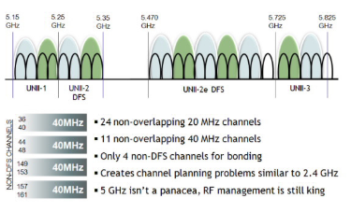
At the 2.4GHz, there are only three non-overlapping channels, making “channel switching” not feasible when dealing with a large number of devices. As seen in the figure provided, lower frequencies often have more non-overlapping channels

Slide 6
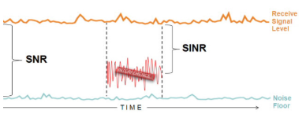
A common metric for predicting how Wi-Fi systems will perform is the Signal-to-Noise (SNR) Ratio. SNR compares the difference between strength of the receive signal level and the noise floor. Typically a higher SNR results in fewer bit errors and higher throughput.
To achieve a high SNR, wireless networks must increase gain or decrease interference. The only way to increase the gain is to add more power

Slide 7
Unlike many other forms of testing, bit error rate, (BER) measures the full end to end performance of a system including the transmitter, receiver and the medium between the two. In this way, bit error rate, BER enables the actual performance of a system in operation to be tested, rather than testing the component parts and hoping that they will operate satisfactorily when in place.
Bit error rate, BER may traditionally be associated with radio communications links, however bit error rate and bit error rate testing is also applicable to other systems such as fibre optic links, Ethernet, or any link over which a digital signal is transmitted.
Bit Error Rate Testing is simple in concept, but often hard to implement. Data received is compared to data transmitted to examine losses. However, WiFi BER specifications are so small that the measurements must be extremely accurate.

Slide 8
2.4GHz vs. 5.8GHz
(802.11b) vs. (802.11a)
When evaluating frequencies, five key factors play a role in deciding superiority:
Range
Transmit Power
Receiver Sensitivity
Noise and Interference
Bit Error Rate
Lower frequencies tend to have better propagation, whereas higher frequencies have longer range when consuming the same power

Slide 9
Reasons for Poor WiFi Performance
Co-Channel interference occurs when two transmissions happen in the same area. The transmitter checks to see if the transmitter is idle or not. If not, the transmitter must wait until the receiver is done receiving.
This is common in high density usage areas, where bad CCI can make it seem like the WiFi isn’t working at all.
Adjacent Channel Interference occurs when transmissions are sent on an overlapping or adjacent channel and bleed-through occurs. ACI is generally more of a problem than CCI. ACI is more prevalent when the receiver has a weak signal and the adjacent channel has a strong signal. The best way to combat ACI is good channel planning.

Slide 10
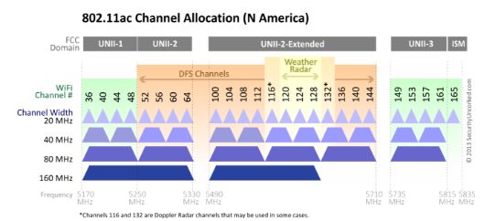

Slide 11
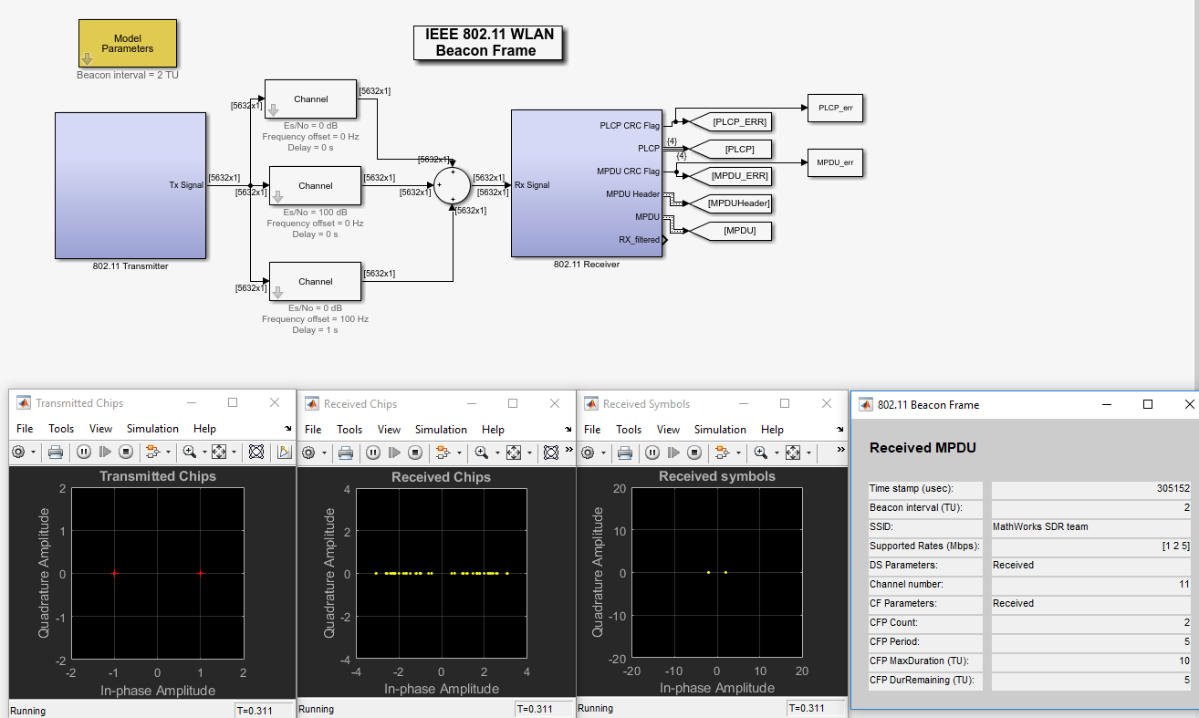

Slide 12
Packet Error Rate Comparison
Main Channel Es/No | PLCP | MPDU
0dB | 17.23 | 95.38%
-1dB | 17.18 | 96.43%
-2dB | 17.00 | 97.15%
-3dB | 17.15 | 97.56%
-4dB | 16.99 | 99.21%
-5dB | 16.00 | 99.25%
-10dB | 17.44 | 100%

Slide 13
Packet Error Rate Comparison Corrected
Main Channel Es/No | MPDU Normalized
0dB | 7.6%
-1dB | 28.6%
-2dB | 43.0%
-3dB | 51.2%
-4dB | 84.2%
-5dB | 85.0%
-10dB | 100%

Slide 14
References
The IEEE standards for each protocol
E. D. Ngangue Ndih and S. Cherkaoui, "On Enhancing Technology Coexistence in the IoT Era: ZigBee and 802.11 Case," in IEEE Access, vol. 4, pp. 1835-1844, 2016.
R. Natarajan, P. Zand and M. Nabi, "Analysis of coexistence between IEEE 802.15.4, BLE and IEEE 802.11 in the 2.4 GHz ISM band," IECON 2016 - 42nd Annual Conference of the IEEE Industrial Electronics Society, Florence, 2016, pp. 6025-6032.
A. Marinčić, A. Kerner and D. Šimunić, "Interoperability of IoT wireless technologies in ambient assisted living environments," 2016 Wireless Telecommunications Symposium (WTS), London, 2016, pp. 1-6.
D. C. Yacchirema, C. E. Palau and M. Esteve, "Enable IoT interoperability in ambient assisted living: Active and healthy aging scenarios," 2017 14th IEEE Annual Consumer Communications & Networking Conference (CCNC), Las Vegas, NV, 2017, pp. 53-58.
6. Mathworks, Matlab/Simulink documentation

